Slide 1
Component & Deployment Diagram

Slide 2
INTRODUCTION
An Uml diagram classification:
Static
Use case diagram, Class diagram
Dynamic
State diagram, Activity diagram, Sequence diagram, Collaboration diagram
Implementation
Component diagram, Deployment diagram
UML components diagrams are
Implementation diagrams: describe the different elements required for implementing a system

Slide 3
Another classification:
Behavior diagrams
A type of diagram that depicts behavior of a system
This includes activity, state machine, and use case diagrams, interaction diagrams
Interaction diagrams
A subset of behavior diagrams which emphasize object interactions. This includes collaboration, activity, sequence diagrams
Structure diagrams
A type of diagram that depicts the elements of a specification that are irrespective of time. This includes class, composite structure, component, deployment
UML components diagrams are structure diagrams

Slide 4
UML component diagrams describe software components and their dependencies to each others
A component is an autonomous unit within a system
The components can be used to define software systems of arbitrary size and complexity
UML component diagrams enable to model the high-level software components, and the interfaces to those components
Important for component-based development (CBD)

Slide 5
Component and subsystems can be flexibly REUSED and REPLACED
A dependency exists between two elements if changes to the definition of one element may cause changes to the other
Component Diagrams are often referred to as “wiring diagrams”
The wiring of components can be represented on diagrams by means of components and dependencies between them

Slide 6
COMPONENT in UML 2.0
Modular unit with well-defined interfaces that is replaceable within its environment
Autonomous unit within a system
Has one or more provided and required interfaces
Its internals are hidden and inaccessible
A component is encapsulated
Its dependencies are designed such that it can be treated as independently as possible

Slide 7



COMPONENT NOTATION
A component is shown as a rectangle with
A keyword <<component>>
Optionally, in the right hand corner a component icon can be displayed
A component icon is a rectangle with two smaller rectangles jutting out from the left-hand side
This symbol is a visual stereotype
The component name

Slide 8
Component ELEMENTS
A component can have
Interfaces
An interface represents a declaration of a set of operations and obligations
Usage dependencies
A usage dependency is relationship which one element requires another element for its full implementation
Ports
Port represents an interaction point between a component and its environment
Connectors
Connect two components
Connect the external contract of a component to the internal structure

Slide 9
INTERFACE
A component defines its behaviour in terms of provided and required interfaces.
An interface
Is the definition of a collection of one or more operations
Provides only the operations but not the implementation
Implementation is normally provided by a class/ component
In complex systems, the physical implementation is provided by a group of classes rather than a single class

Slide 10
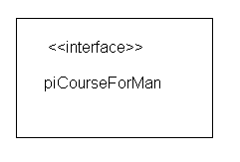
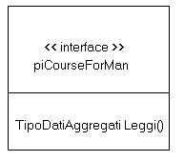
INTERFACE
May be shown using a rectangle symbol with a keyword <<interface>> preceding the name
For displaying the full signature, the interface rectangle can be expanded to show details
Can be
Provided
Required

Slide 11

INTERFACE
A provided interface
Characterize services that the component offers to its environment
Is modeled using a ball, labelled with the name, attached by a solid line to the component

Slide 12

A required interface
Characterize services that the component expects from its environment
Is modeled using a socket, labelled with the name, attached by a solid line to the component

Slide 13


INTERFACE
Where two components/classes provide and require the same interface, these two notations may be combined
The ball-and-socket notation hint at that interface in question serves to mediate interactions between the two components
If an interface is shown using the rectangle symbol, we can use an alternative notation, using dependency arrows

Slide 14
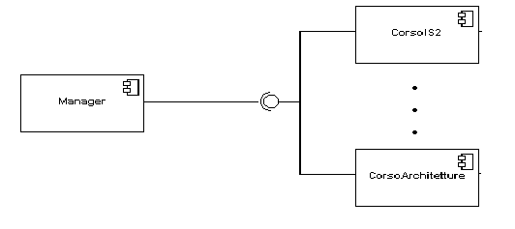
INTERFACE
In a system context where there are multiple components that require or provide a particular interface, a notation abstraction can be used that combines by joining the interfaces
A component
Specifies a CONTRACT of the services that it provides to its clients and that it requires from others components in terms of its provided and required interfaces
Can be replaced
The system can be extended

Slide 15

DEPENDENCIES
Components can be connected by usage dependencies
Usage Dependency
A usage dependency is relationship which one element requires another element for its full implementation
Is a dependency in which the client requires the presence of the supplier
Is shown as dashed arrow with a <<use>> keyword
The arrowhead point from the dependent component to the one of which it is dependent

Slide 16
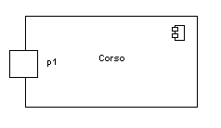
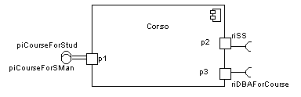
PORT
Specifies a distinct interaction point
Between that component and its environment
Between that component and its internal parts
Is shown as a small square symbol
Ports can be named, and the name is placed near the square symbol
Is associated with the interfaces that specify the nature of the interactions that may occur over a port

Slide 17

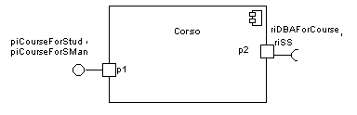
PORT
Ports can support unidirectional communication or bi-directional communication
If there are multiple interfaces associated with a port, these interfaces may be listed with the interface icon, separated by a commas

Slide 18

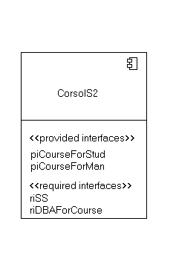
EXTERNAL VIEW
A component have an external view and an internal view
An external view (or black box view) shows publicly visible properties and operations
An external view of a component is by means of interface symbols sticking out of the component box
The interface can be listed in the compartment of a component box

Slide 19
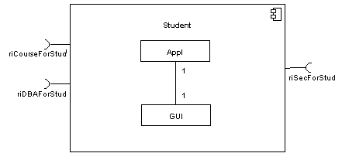
INTERNAL VIEW
An internal, or white box view of a component is where the realizing classes/components are nested within the component shape
Realization is a relationship between two set of model elements
One represents a specification
The other represent an implementation of the latter

Slide 20
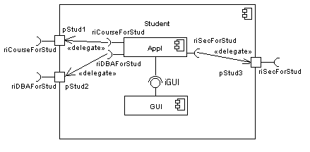

Slide 21

ASSEMBLY
Two kinds of connectors:
Delegation
Assembly
ASSEMBLY CONNECTOR
A connector between 2 components defines that one component provides the services that another component requires
He must only be defined from a required interface to a provided interface
An assembly connector is notated by a “ball-and-socket” connection

Slide 22
DELEGATION
DELEGATION CONNECTOR
Links the external contract of a component to the internal realization
Represents the forwarding of signals
He must only be defined between used interfaces or ports of the same kind

Slide 23
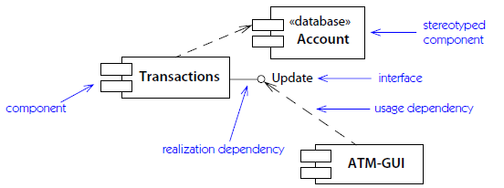

Slide 24
DEPLOYMENT DIAGRAMS
There is a strong link between components diagrams and deployment diagrams
Deployment diagrams
Show the physical relationship between hardware and software in a system
Hardware elements:
Computers (clients, servers)
Embedded processors
Devices (sensors, peripherals)
Are used to show the nodes where software components reside in the run-time system

Slide 25
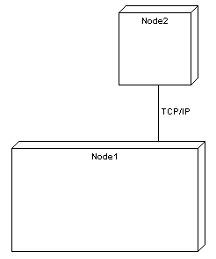
Deployment diagram
Contains nodes and connections
A node usually represent a piece of hardware in the system
A connection depicts the communication path used by the hardware to communicate
Usually indicates the method such as TCP/IP

Slide 26
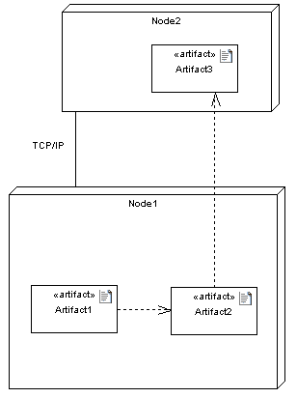
Deployment diagrams contain artifact
An artifact
Is the specification of a phisycal piece of information
Ex: source files, binary executable files, table in a database system,….
An artifact defined by the user represents a concrete element in the physical world

Slide 27
